Slide 1
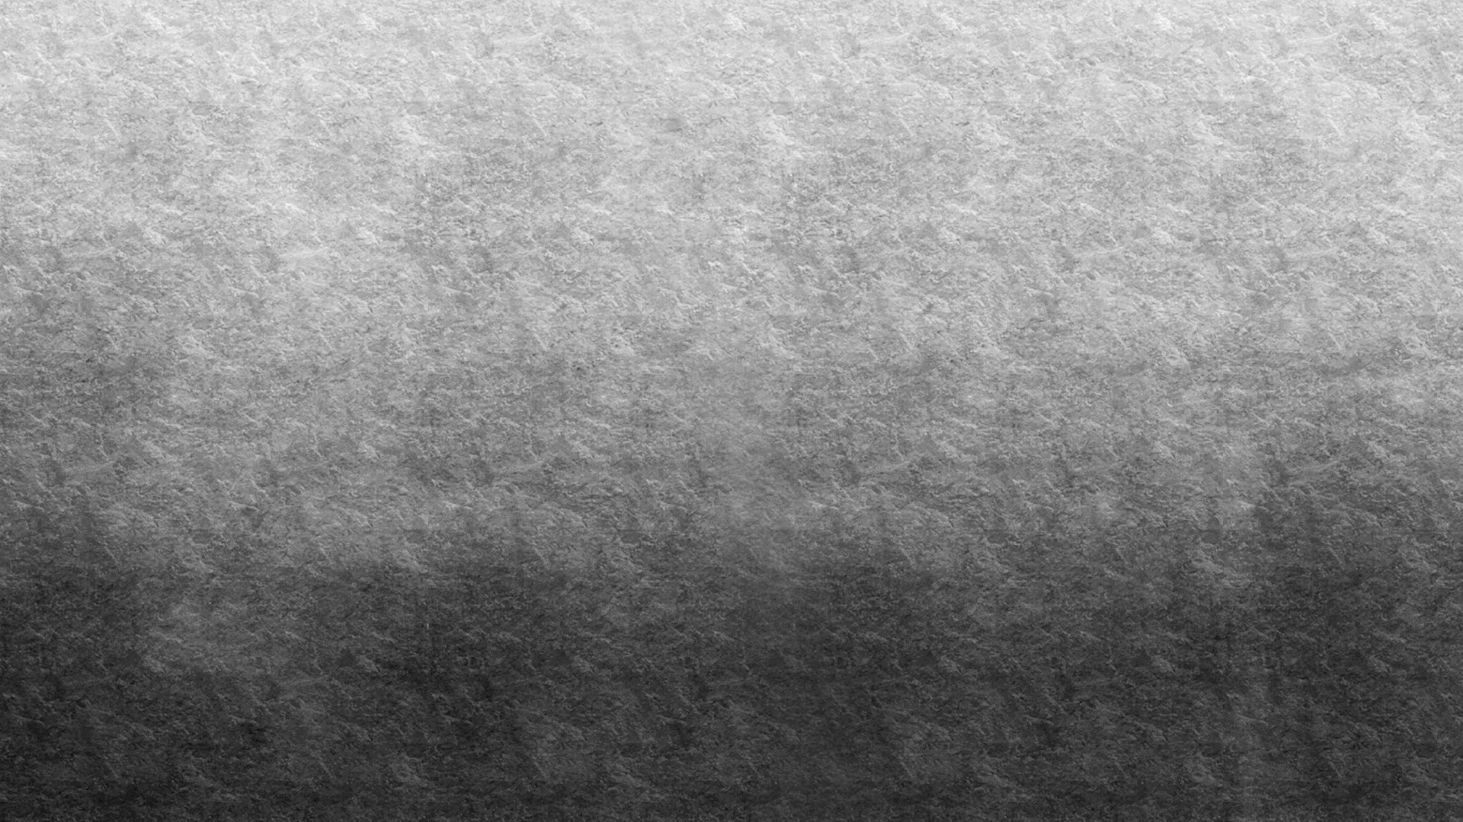
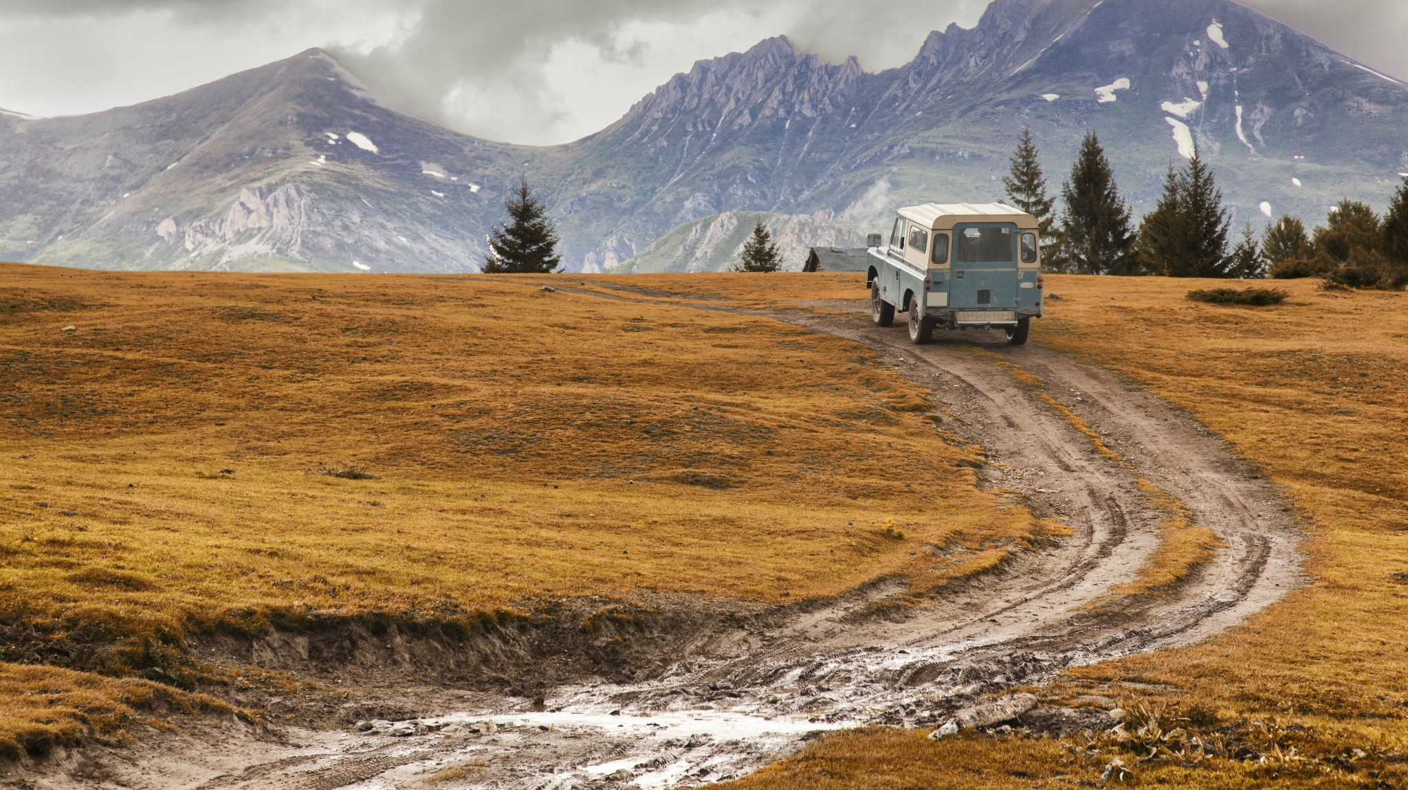
Landscapes and GANs
Chinmay Garg

Slide 2
Motivation
How is a GAN able to generate images that can differ from the artwork that it has been trained on?
How can human input of the artwork as a baseline for generation affect the output?
How can I curate the input in order to generate artwork to overcome the limitations of the trained model?
Does creating artwork in applications such as Processing etc. help the neural network avoid uncertainty when trying to detect and understand the input?
And overall achieve a better understanding of GANs

Slide 3
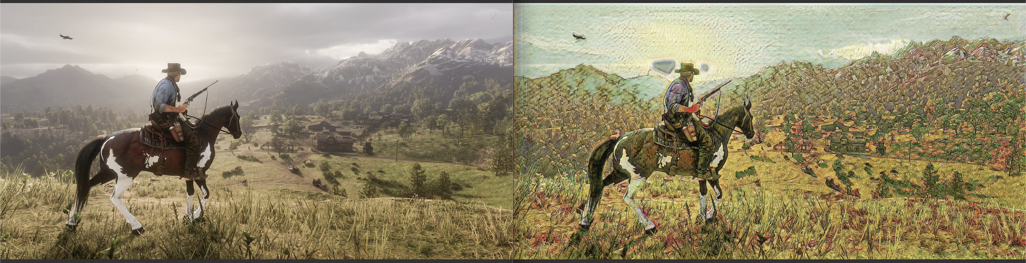
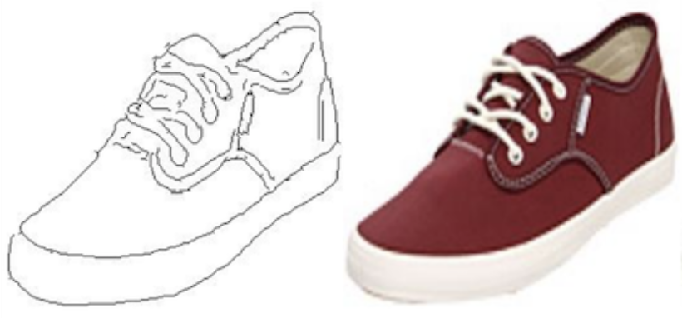
Overview
Determining the connection between GAN - style converted and generated artworks with standard computationally created landscape art.
Made a Processing Library to quickly add elements commonly found in certain landscapes
And using the naïve drawing of a landscape and a GAN to generate an artistically pleasing output in a more realistic style
Using SPADE-Landscape, CycleGAN and PhotoSketch models in RunwayML

Slide 4
LandscapeMaker Library
Simple and easy to use abstractions for common landscape elements
Used to quickly draw out landscape designs along with other Processing libraries
Example methods:
Sun(type, x, y)
Snow(quantity)
mountains(numOfRanges)
Detailed documentation on the library and all methods available on GitHub along with examples

Slide 5
Inputs & Observations

Slide 6
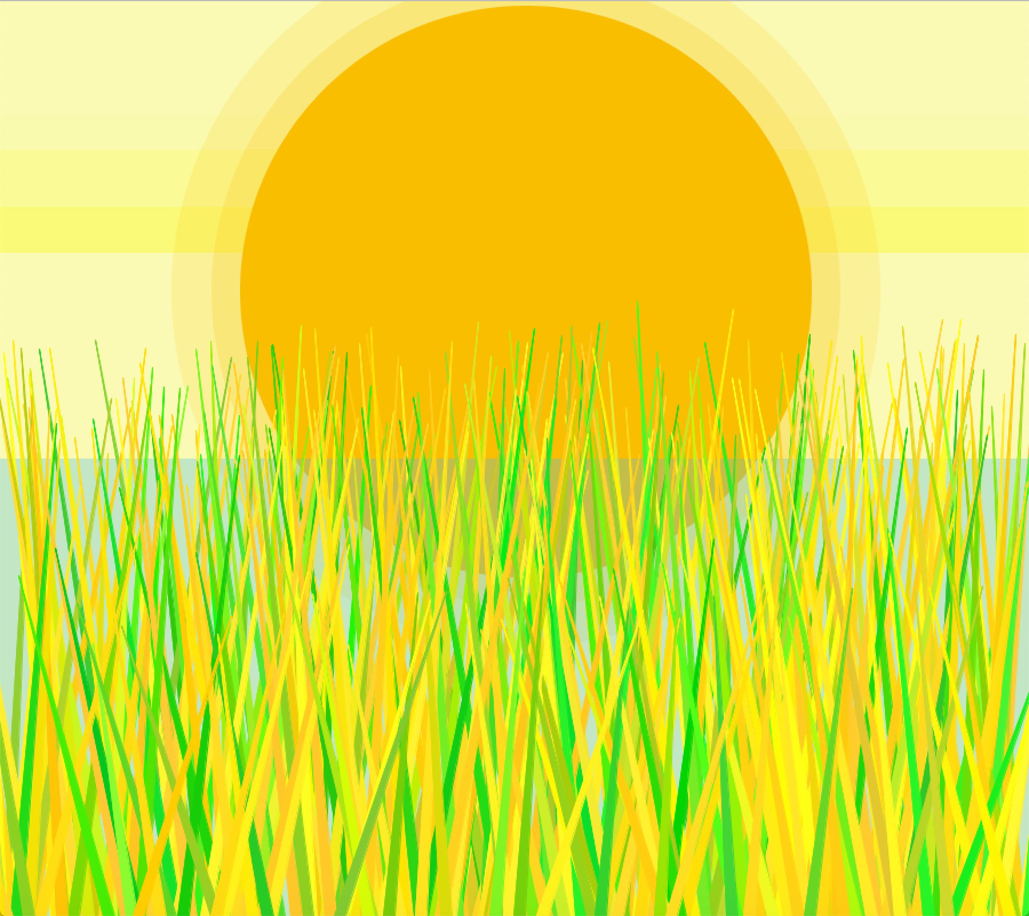
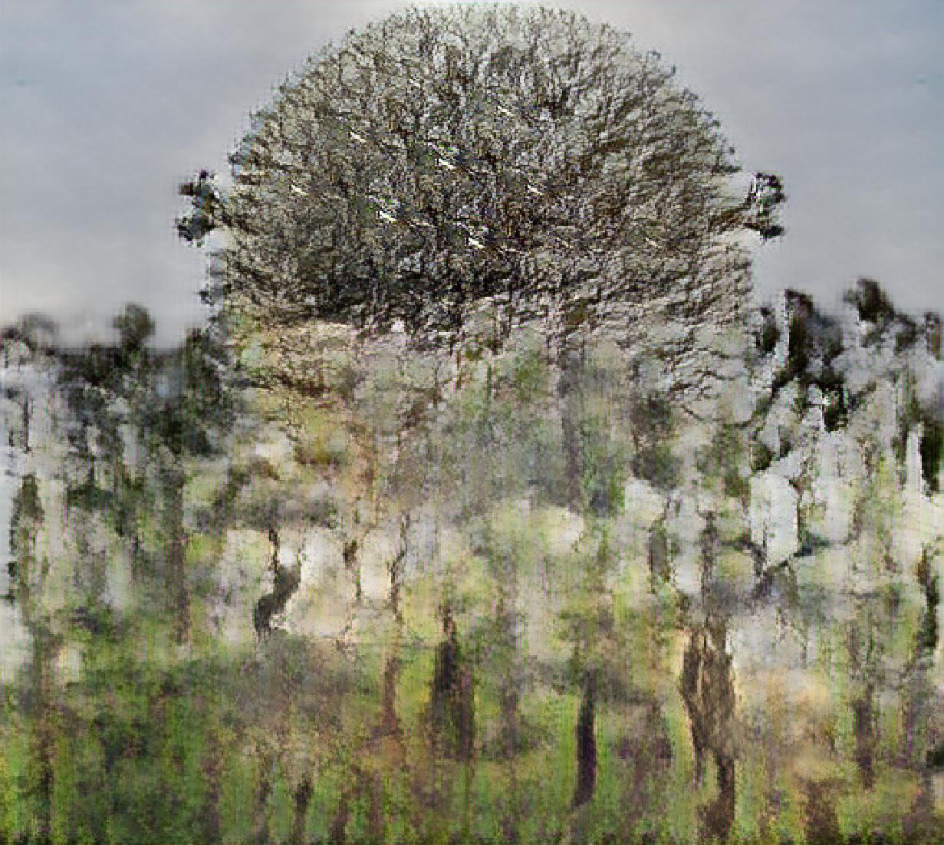
Using SPADE Landscape (no-preprocessing)
This image was made using Processing and then fed directly into SPADE Landscape GAN in RunwayML

Slide 7
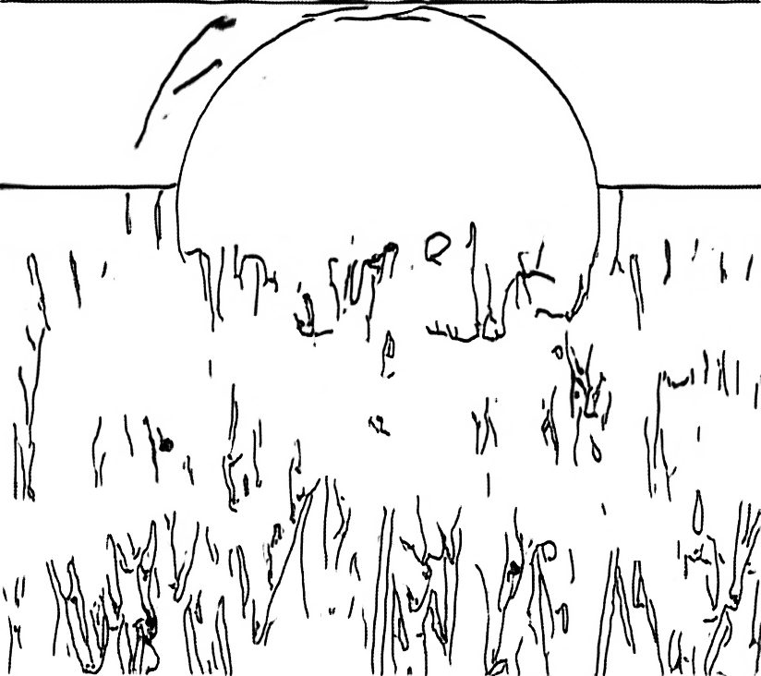
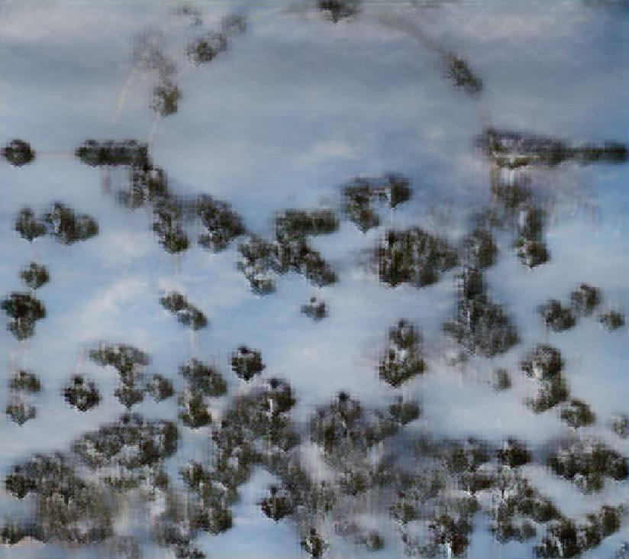
Using PhotoSketch - SPADE Landscape
This original image was converted into a sketch using PhotoSketch for a more hand-drawn look and then fed into SPADE Landscape

Slide 8
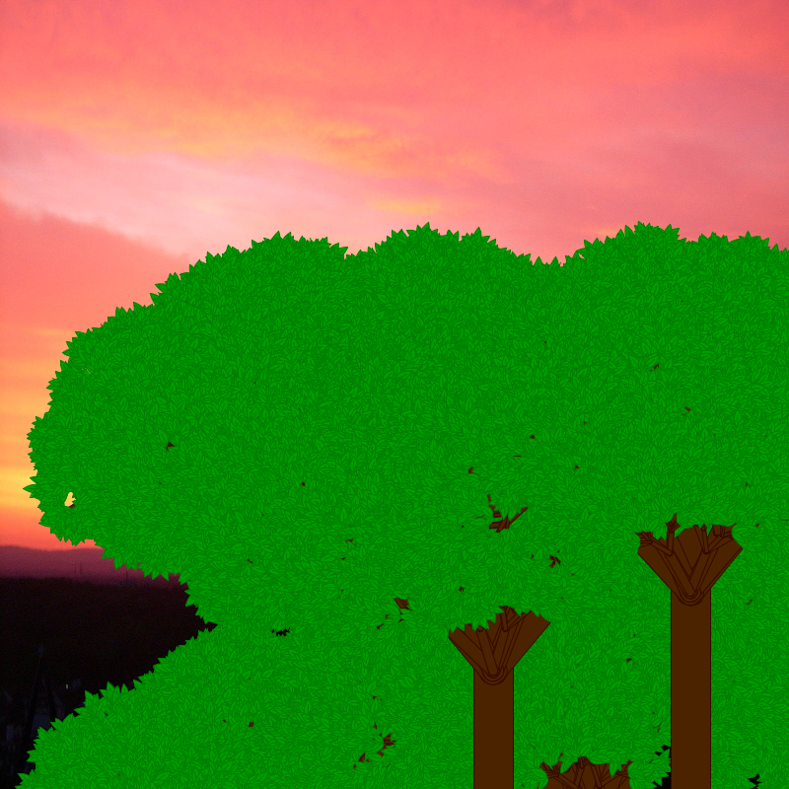
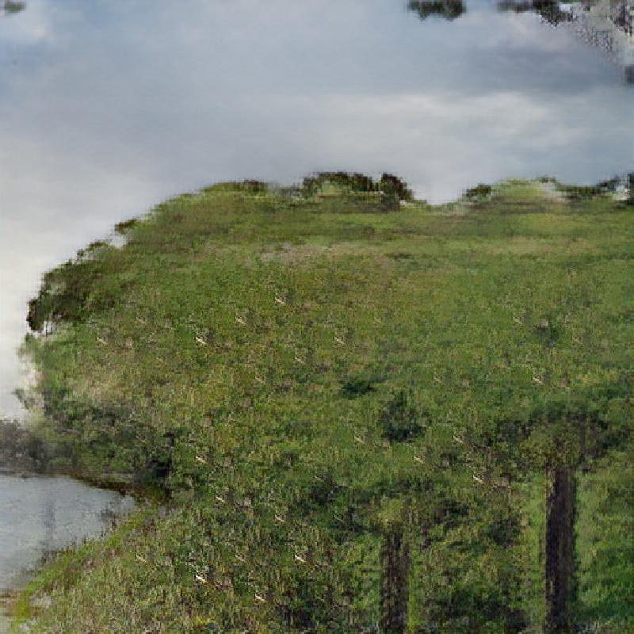
Using SPADE Landscape (no-preprocessing)
Because of the very color contrast nature of the image the GAN was able to distinguish between vegetation and the sky easily while filling other gaps

Slide 9
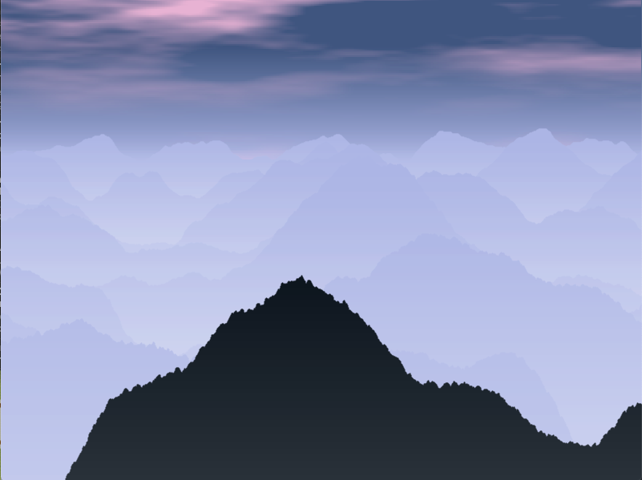
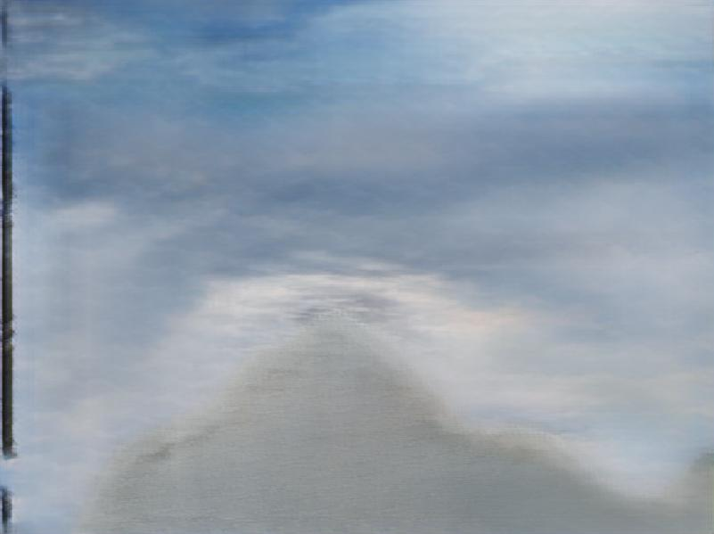
Using SPADE Landscape – (gaussian blur)
Notes:
William Turner

Slide 10
Some Final Pieces

Slide 11
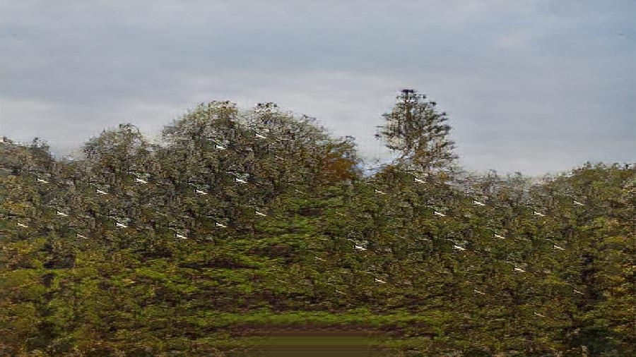

Slide 14
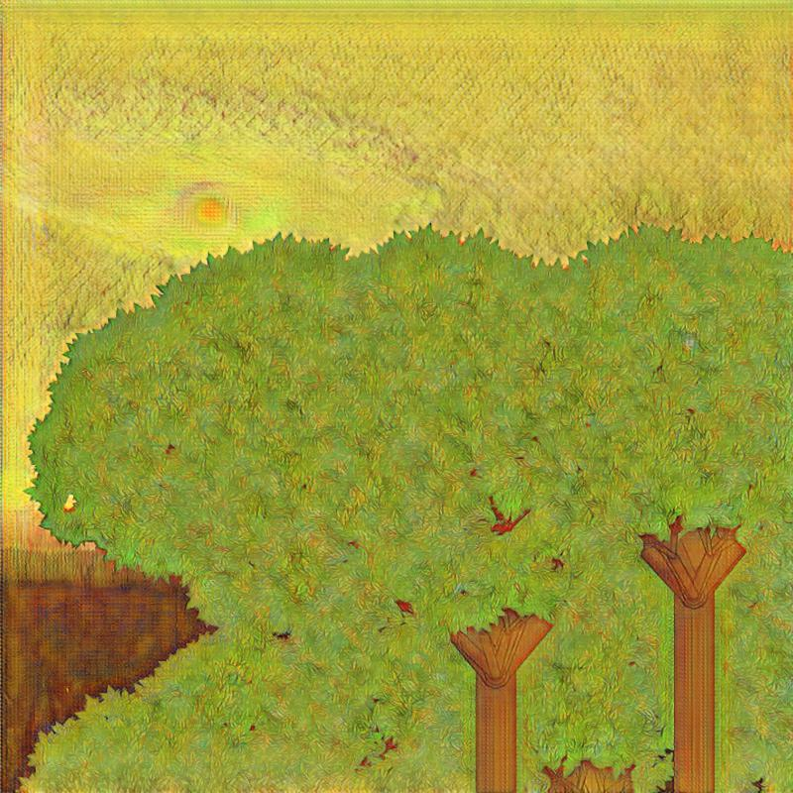

Slide 15
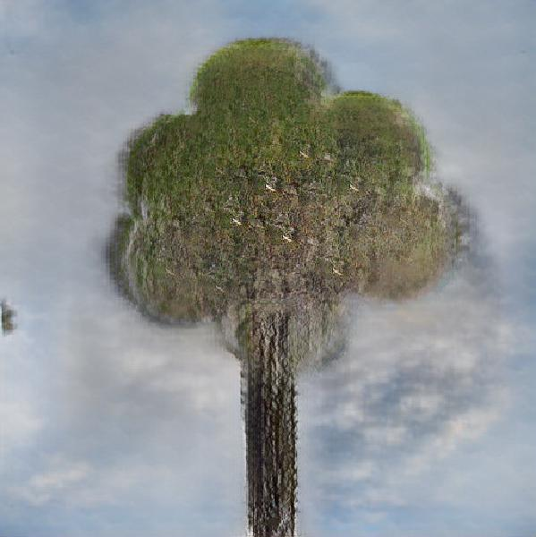

Slide 16
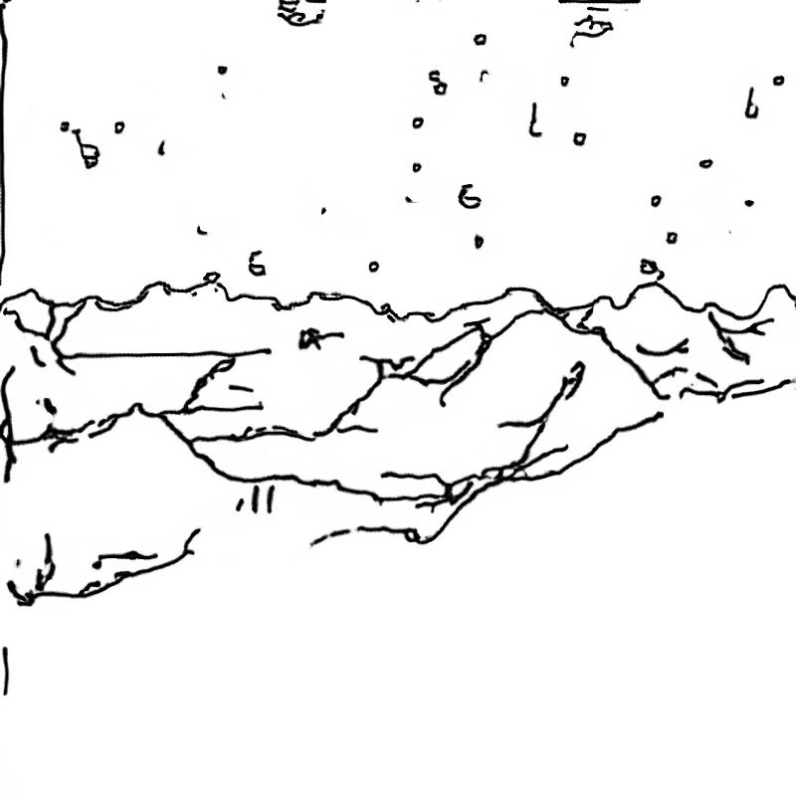

Slide 17
Conclusion
The way the GAN is trained limits the type of input you can provide in order to achieve a high-quality result
SPADE Landscape is trained on a set of landscape pictures and hand-drawn images for accuracy in converting hand-drawn images into landscapes
Computer drawing images confuse the model and it produces vague output when it cannot recognize the exact pattern, making less complex input images easier to generate.
It’s hard to classify what looks aesthetically pleasing as each model has its own set of limitations and abstracts landscapes enough to feel new

Slide 18
Future Steps
Train a GAN on data similar to the kind of input I want to be able to give
Add more options and polish the library. And think about if the additions of more elements makes sense?
Try to port the CycleGAN rendering as a mod for RDR2

Slide 19
Thank you

Slide 20
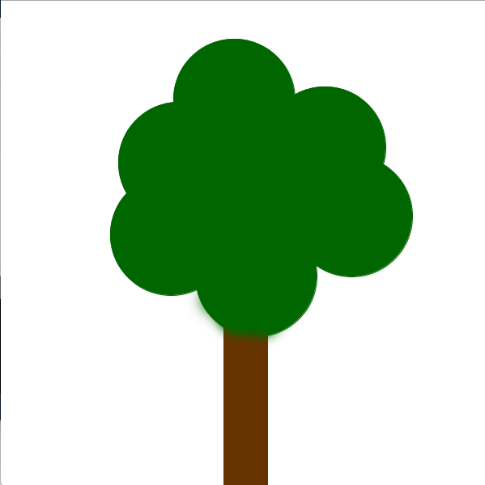
SPADE Landscape
No pre-processing

Slide 21
SPADE Landscape
No Preprocessing

Slide 22
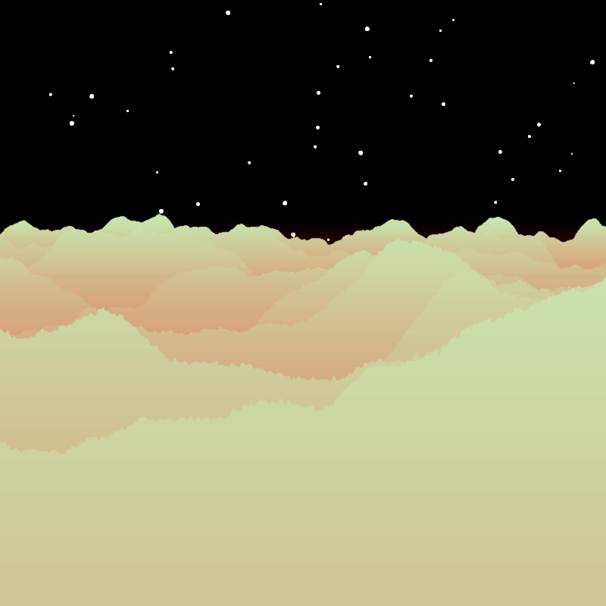
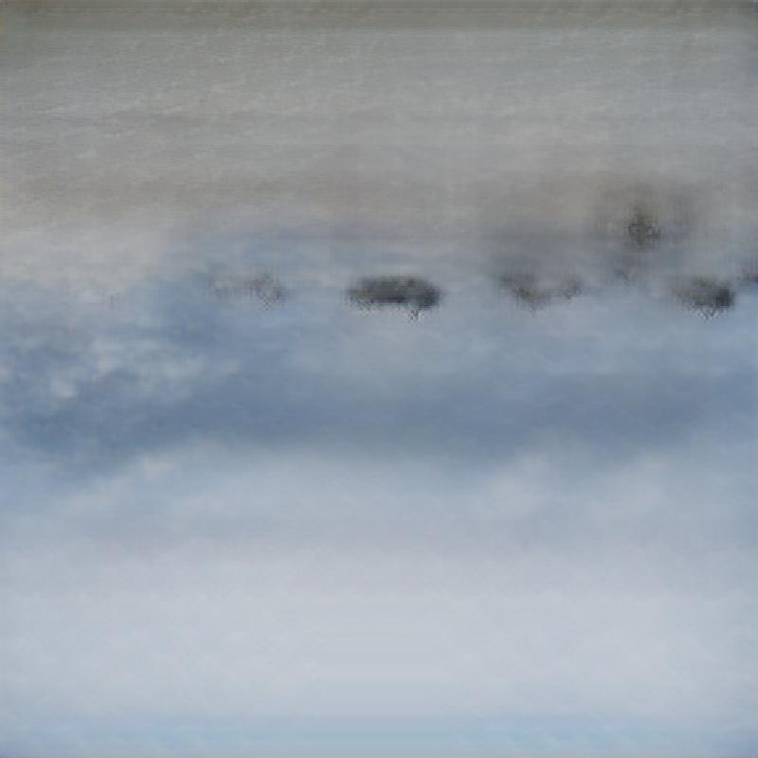
SPADE Landscape
No Blur

Slide 23
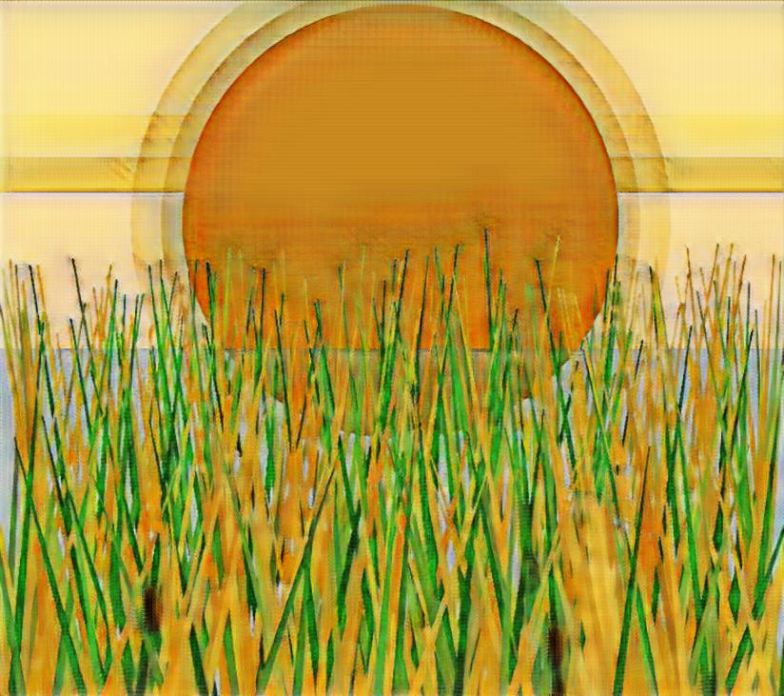
Style Transfer
No Preprocessing and Style Transfer

Slide 24
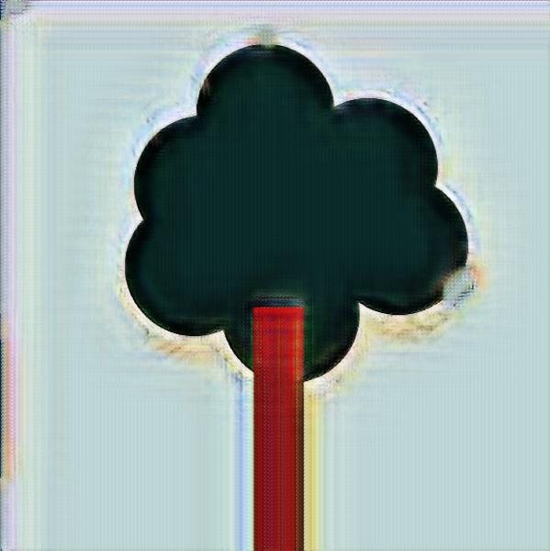
Style Transfer
Inversion and Style Transfer

Slide 25
Style Transfer
No Preprocessing and Style Transfer

Slide 26
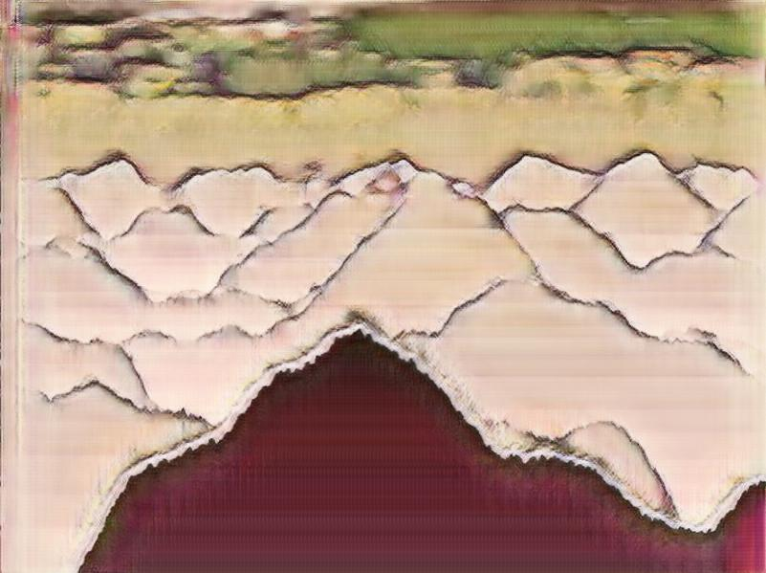
Style Transfer
Blue, Invert and Style Transfer

Slide 27
Style Transfer
No Pre-Processing

Slide 28
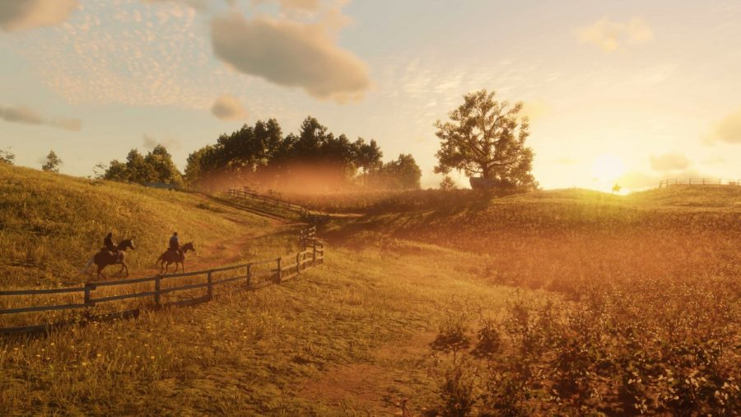
Style Transfer
90% Gaussian Blur

Slide 29
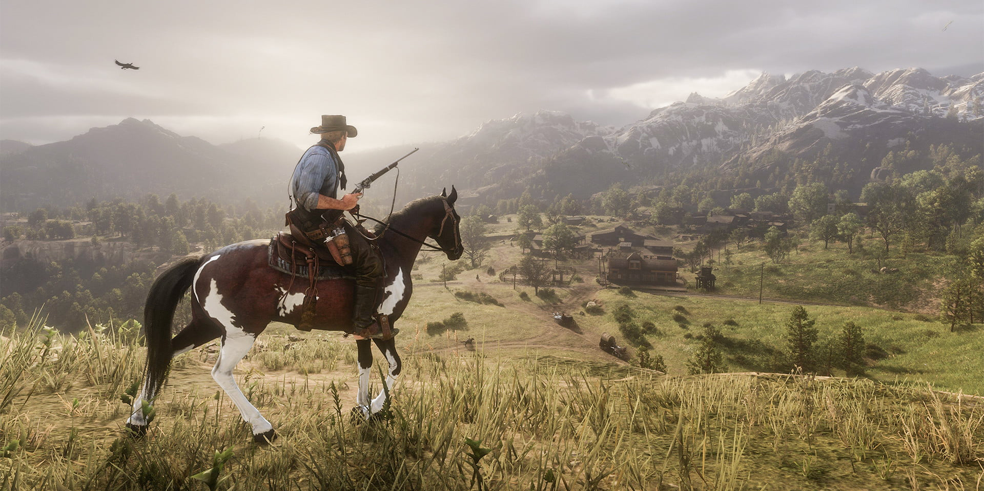
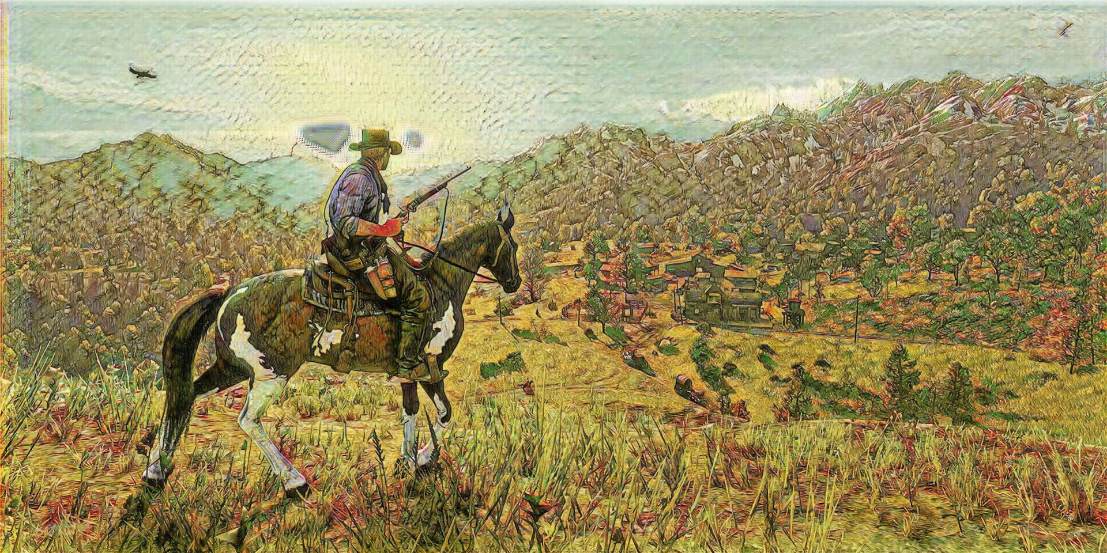
Style Transfer
Style transfer and no pre-processing

Slide 30
SPADE Landscape
No Blur and Color Correction

